Slide 1
Cardiosave Software Revisions
B.17 / C.06 - D.00 Software
Notes:
Field and Customer facing

Slide 2
Cardiosave Version B.17 / C.06 to D.00 Software
Background
Creates one version of Cardiosave software for Getinge markets worldwide.
  Currently, different software versions exist because of different regulatory requirements around the world.
Adds software enhancements and addresses maintenance items.
Enhances battery messages, supports battery maintenance, and provides additional battery capacity information.
Enhances cybersecurity protections.
Improves service diagnostics.
Corrects software anomalies.
Notes:
Field and Customer facing

Slide 3
Cardiosave Version B.17 / C.06 to D.00 Software
Background
The following slides outline the changes that may be apparent during everyday use of Cardiosave.
The revisions can result in the following:
Change in operation.
New messages on the monitor display.
Additional information in the Help Screens.
New key and additional information on the Touchscreen.
Notes:
Field and Customer facing

Slide 4
Cardiosave Version B.17 / C.06 to D.00 Software
Background
Field Safety Corrective Actions Addressed
Cardiosave Software Version D.00 Addresses three (3) open Field Safety Corrective Actions (FSCA).
  Cybersecurity Vulnerabilities– Ripple20
  Battery Usage, Charging, Maintenance and Storage Instructions
  (Part of this FSCA was completed at an earlier date as part of the release of
  the Cardiosave Li-Ion Battery Transport and Storage Case.)
  Shutdown Upon Battery Removal
Notes:
Field facing

Slide 5
Flat Arterial Pressure (A.P.) surveillance
Notes:
Field and Customer facing

Slide 6
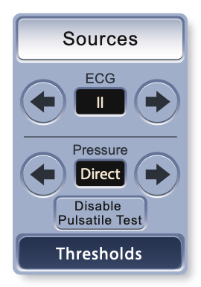
Flat Arterial Pressure (A.P.) surveillance
Applicable software versions
Cardiosave with C.06 software currently has this feature and will continue to have this feature when the system is upgraded to D.00.​
Notes:
Field and Customer facing

Slide 7
Flat Arterial Pressure (A.P.) surveillance
Reason for update
This change was implemented to comply with new regulatory standards, which require detection and an alarm for a blood pressure monitoring fault.
Description
With this software change, the system performs a flat A.P. surveillance check of the arterial pressure source.
  Monitors for sustained loss of pulsatility on the A.P. waveform when pulsatility is expected.
If a sustained loss of pulsatility is detected, No Pressure Source Available - Medium Priority Alarm will occur.
Notes:
Field and Customer facing

Slide 8
Flat Arterial Pressure (A.P.) surveillance
Newly added probable cause for existing Medium Priority Help Screen
Prior to updating B.17 software, the only probable cause listed for the No Pressure Source Available alarm was ”No DIRECT or EXTERNAL arterial pressure (A.P) source was detected.”
The newly added probable causes include:
  The A.P. transducer has been vented to the atmosphere for more than 10 seconds.
  The pressure monitoring tubing has become disconnected.
  The pressure monitoring lumen of the IAB may have become restricted due to clot formation and is producing a flat A.P. waveform.
  A defective A.P. transducer or pressure transducer cable produces a flat A.P. waveform.
Notes:
Field and Customer facing

Slide 9
Flat Arterial Pressure (A.P.) surveillance
Current probable cause for existing Medium Priority Help Screen
No Pressure Source Available
No DIRECT or EXTERNAL arterial pressure (A.P) source was detected.
If using a Fiber-Optic IAB, ensure that the Fiber-Optic Sensor Cable is connected. Once connected, a calibration will occur automatically in 20 seconds. If a transducer is in use, ensure that the pressure cable is connected to the transducer and the IABP. If the alarm persists, consider replacing the pressure cable. If an A.P. source is still unavailable, consider providing an A.P. signal using an interface cable from the high level output of an external monitor to the IABP. Manually switch the IABP’s pressure input to EXTERNAL using the PRESSURE ARROW keys in the SOURCES Menu.
Notes:
Field and Customer facing

Slide 10
Flat Arterial Pressure (A.P.) surveillance
Newly added probable cause for existing Medium Priority Help Screen
No Pressure Source Available
The A.P. transducer has been vented to atmosphere for more than 10 seconds.
Verify that the transducer is not vented to atmosphere. If vented, reestablish A.P. pulsatility by closing the vent stopcock.
The pressure monitoring tubing has become disconnected.
Verify the integrity of the pressure monitoring lines and luer connectors. Correct per hospital pressure monitoring procedures.
Notes:
Field and Customer facing

Slide 11
Flat Arterial Pressure (A.P.) surveillance
Newly added probable cause for existing Medium Priority Help Screen
No Pressure Source Available
The pressure monitoring lumen of the IAB may have become restricted due to clot formation and is producing a flat A.P. waveform.
Attempt to aspirate the inner lumen. If you met resistance during aspiration, consider the inner lumen to be occluded. Discontinue the use of the inner lumen by placing a luer cap on the female luer hub of the inner lumen. Provide an alternate A.P. source (i.e. radial) by connecting and zeroing a standard transducer. If an alternate A.P. source (i.e. radial pressure source) is not available, connect an interface cable from the A.P. high level output of an external monitor to the IABP. Manually switch the IABP’s pressure input to EXTERNAL using the PRESSURE ARROW keys in the SOURCES Menu. If an alternate A.P. source is not available, override the alarm by pressing the DISABLE PULSATILE TEST button in the SOURCES menu.
Notes:
Field and Customer facing

Slide 12
Flat Arterial Pressure (A.P.) surveillance
Newly added probable cause for existing Medium Priority Help Screen
No Pressure Source Available
A defective A.P. transducer or pressure transducer cable is producing a flat A.P. waveform.
Check for damage to the pressure transducer cable. Consider replacing the pressure transducer cable and pressure transducer. If alarm persists, provide an alternate A.P. source (i.e. radial) by connecting and zeroing a standard transducer or by connecting an interface cable from the A.P. high level output of an external monitor to the IABP. Manually switch the IABP’s pressure input to EXTERNAL using the PRESSURE ARROW keys in the SOURCES Menu. If an alternate A.P. source is not available, override the alarm by pressing the DISABLE PULSATILE TEST button in the SOURCES menu.
Notes:
Field and Customer facing

Slide 13
Flat Arterial Pressure (A.P.) surveillance
Clinical considerations
The Disable Pulsatile Test key allows the user to suspend the Flat Arterial Pressure (A.P.) Surveillance checks.
  Disabling the pulsatility check can accommodate the following:
    The absence of pulsatility, which can exist when IAB support is temporarily paused while the patient is concurrently being supported with a non-pulsatile mechanical circulatory support device.
    When persistent conditions persist, such as a clotted A.P. lumen.
          If the pressure monitoring lumen of the IAB is clotted, provide an alternate A.P. source.

Slide 14
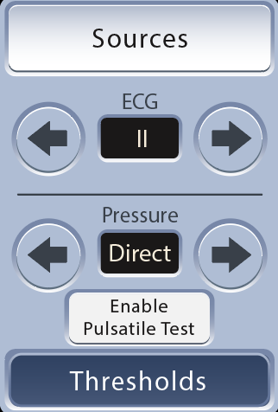

Flat Arterial Pressure (A.P.) surveillance
Clinical considerations
The flat A.P. surveillance can be resumed by pressing the Enable Pulsatile Test key.
The pump will also automatically resume the flat A.P. surveillance check after detecting 30 continuous seconds of pulsatility on the waveform.

Slide 15
Docking Status Banner on Monitor Display

Slide 16
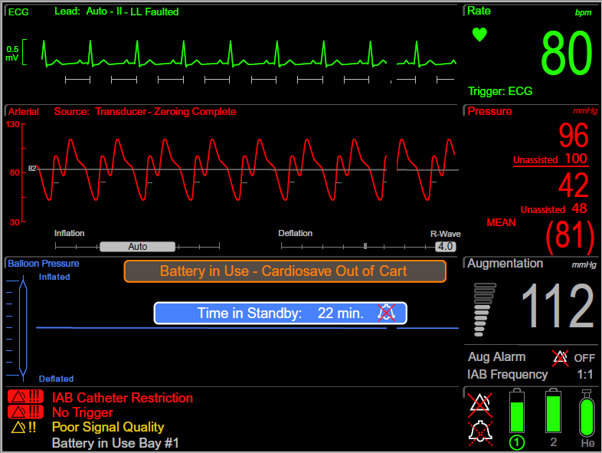
Docking Status Banner on Monitor Display
Newly added Status Indicators
Reason for update
Operators of the Cardiosave IABP may be unaware that the IABP Console has not been fully docked into the cart.
This software change is intended to increase the user's awareness that the IABP Console is not properly docked into the cart.
If not securely docked into the cart, Cardiosave will continue to operate on battery power until the batteries are fully depleted, leading to a shutdown of the IABP Console.

Slide 17
Docking Status Banner on Monitor Display
Newly added Status Indicators
Description
The following changes were made to the Monitor Display:
  The Time in Standby banner was relocated slightly lower.
  The new banner, Battery in Use – Cardiosave Out of Cart, will be displayed whenever the Cardiosave IABP Console is not securely docked into the hospital cart and running on battery power.

Slide 18

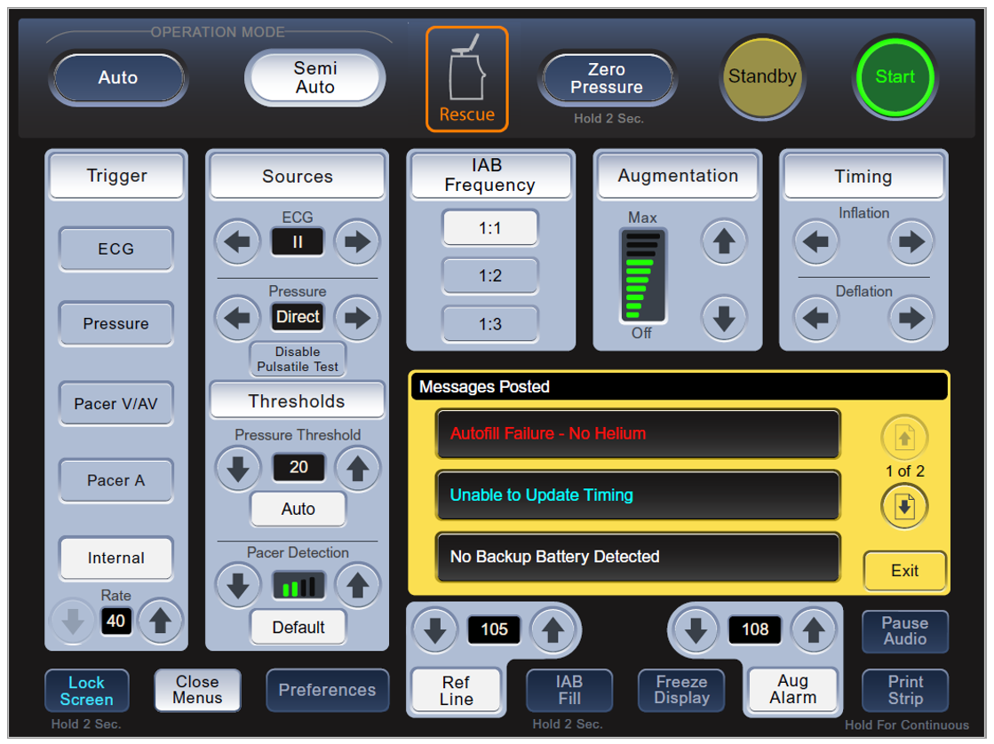
Docking Status Banner on Monitor Display
Newly added Status Indicators
Description
The following changes were made to the Touchscreen :
  An orange border has been added around the Rescue icon when the IABP Console is not securely docked in the Hospital Cart.
  When the IABP is in Rescue Mode, the orange border will continuously flash between dark orange and light orange.
  If the IABP is set up in the Hybrid Mode and the Rescue icon is displayed on the Touchscreen, ensure that the IABP Console is securely docked in the Hospital Cart.

Slide 19
Software Version added to Preferences Menu

Slide 20
Software Version in Preferences Menu
Reason for update
This allows the user access to Cardiosave’s current software version while in clinical mode.
  For ease in identifying current software version when required:
    When contacting Getinge with questions
    For proper assistance while troubleshooting
    Product complaint reporting

Slide 21
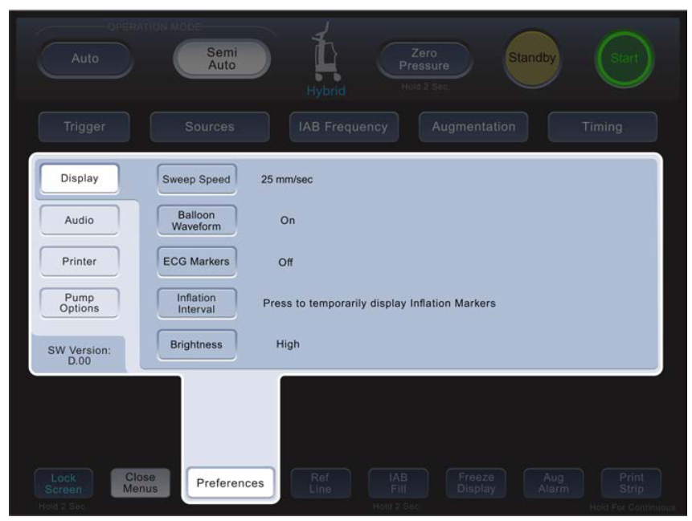
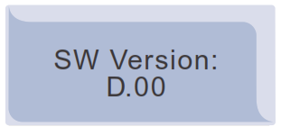
Software Version in Preferences Menu
Description
The installed software (SW) version will be displayed in the lower-left corner of the Preference Menu.
If this information is absent, the software has not been updated to D.00 SW.
Software Version

Slide 22
System power down/power up

Slide 23
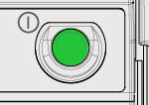
System power down/power up
Reason for update
Due to characteristics of electronic components, rapidly powering down and then powering up the system can have undesirable effects on operation.
There are no known issues with the previous B.17 or C.06 software, but this will ensure safer power down/power up sequences.
This update will prevent the user from restarting the unit within 10 seconds of a previous shutdown.
Description
Whenever the Cardiosave system is powered down, the user will be unable to restart the unit for 10 seconds.
The power button LED will flash during this 10 second period.
Power Button
LED will flash

Slide 24
Unexpected Shutdown Upon Battery Removal

Slide 25
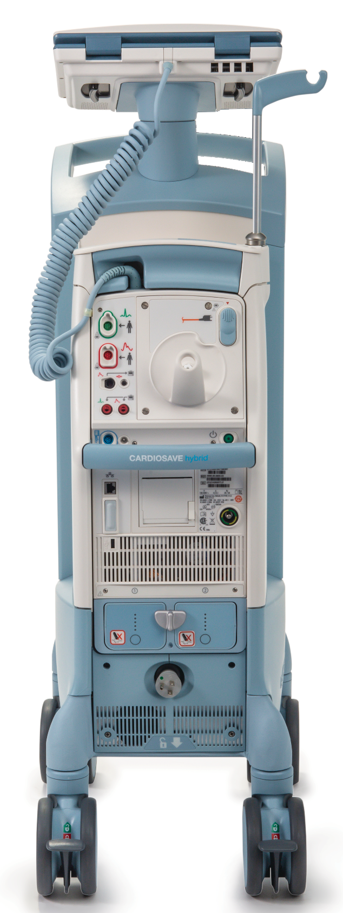
Unexpected Shutdown Upon Battery Removal
Reason for update
Previously Datascope/Getinge initiated a voluntary Medical Device Correction for the Cardiosave Hybrid Intra-Aortic Balloon Pump (IABP) due to unexpected shutdown upon battery removal.
Prior to D.00 software, during a very specific set of conditions, the Cardiosave Hybrid IABP could unexpectedly shut down when the device was running on AC power, only one battery installed in the IABP, and the battery was physically removed while the battery was being charged.
Description
The system will now recognize the charging battery’s removal, disconnect the battery charging system and also switch to AC power without interruption of therapy.
Cardiosave Hybrid

Slide 26
Battery Charge Level Unavailable Bay #___

Slide 27

Battery Charge Level Unavailable Bay #___
Newly added High Priority Alarm
Note
With this revision, it is possible to have a functioning battery but not have current battery information on the screen. A High Priority Alarm and Help Screen has been added to the system.
Battery icon

Slide 28

Battery Charge Level Unavailable Bay #___
Newly added High Priority Alarm
    Alarm event
        The indicated battery is unable to communicate its charge level to the IABP.
    IABP response
    Cardiosave will continue to deliver active IABP therapy.
    The High Priority Alarm Icon - red flashing alarm icon with three (3) exclamation points will be visible on the Monitor Display.
    The uniform audio tone for High Priority Alarms will be played in the following sequence:
          five notes - short pause - five notes - long pause; the cycle repeats.
    Alarm reset event
    When the battery is replaced.
High priority alarm icon

Slide 29
Battery Charge Level Unavailable Bay #___
Newly added High Priority Help Screen
Battery Charge Level Unavailable Bay #___
The battery in the identified bay or bays is unable to communicate the battery charge level.
Immediate battery replacement is required. Replace the battery that is currently in use. If a fully charged battery is not available, connect to an AC power source as soon as possible. If battery operation on the indicated battery is required, monitor the system closely for a system shutdown, the Low Battery Alarm will not be displayed. Contact MAQUET Service to obtain a new battery.

Slide 30
Battery Maintenance Required Bay #___

Slide 31
Battery Maintenance Required Bay #___
Newly added Informational Message
    Alarm event
        Previous Maintenance date is past due.
    IABP response
    An informational message will be posted on startup and remain displayed for 5 minutes or until the Cardiosave IABP starts assisting.
    The Informational audio tone shall sound for 60 seconds or until the pump begins assisting.
    Informational message reset event(s)
    When battery maintenance has been performed, the battery requiring maintenance has been replaced, or the START key is pressed, initiating IABP assistance.

Slide 32
Battery Maintenance Required Bay #___
Newly added Informational Message
    During the initiation of therapy
        Verify that the power cord is plugged into an appropriate AC power outlet and continue operation on AC power.
        If battery operation is required, the battery run time may be reduced and the battery gauges may not reflect the remaining battery charge accurately.
          Consider replacing the affected battery with a fully charged replacement battery, if available.
          Monitor the system closely for a Low Battery alarm.
          If a Low Battery alarm occurs, immediately connect the system to AC power or install a fully charged battery.
        Contact your facility’s Biomedical Services department to inform them of the Battery Maintenance Required Informational Message.

Slide 33
Battery Maintenance Required Information
Newly added Informational Message Help Screen
Battery Maintenance Required Bay #___
The battery in the identified bay requires maintenance.
Continue operation on AC power. If battery operation is required, the battery run time may be reduced. Monitor the system closely for a Low Battery alarm. If a Low Battery alarm occurs, immediately connect the system to AC power or install a fully charged battery. As soon as possible, execute the Battery Maintenance process as follows: Connect the IABP to an AC power source.
Notes:
Field and Customer facing

Slide 34
Battery Maintenance Required Information
Newly added Informational Message Help Screen
Battery Maintenance Required Bay #___
The battery in the identified bay requires maintenance.
Power down the IABP. Pressing and continue to hold the Pressure “Vent” button. This button is on the rear panel and is labeled in red with “->0<-“. Press the “Power” button to turn on the system. Wait until the rotating symbol on the lower display changes direction to a clockwise rotation. Release the “Vent” button. Wait for the Special Menu to display.
Notes:
Field and Customer facing

Slide 35
Battery Maintenance Required Information
Newly added Informational Message Help Screen
Battery Maintenance Required Bay #___
The battery in the identified bay requires maintenance.
Press the Battery Maintenance key in the touch screen display. Press the Run button to start the process. Wait for the status field to indicate the process has been completed.
Notes:
Field and Customer facing

Slide 36
Battery Maintenance Required Information
Warning
The battery maintenance process will take up to 22 hours for each battery and will completely drain the selected battery.
Ensure a second fully charged battery is available before starting the Battery Maintenance process.
Note
Turning off the unit or aborting the battery maintenance procedure before completion will end the process without saving the final results.
Battery maintenance will need to be repeated from the beginning without interruption to completion for proper conditioning of the battery to occur.
Notes:
Field and Customer facing

Slide 37
Battery Replacement Required Bay #___
Notes:
Field and Customer facing

Slide 38
Battery Replacement Required Bay
Newly added Informational Message
    Alarm event
        The indicated battery has failed a system check for battery reliability.
        IABP response
    An informational message will be posted on startup and remain displayed for 5 minutes or until the Cardiosave IABP starts assisting.
    The Informational audio tone shall sound for 60 seconds or until the pump begins assisting.
    Informational message reset event(s)
    The reset shall occur when either the battery has been replaced or the START key is pressed and therapy is initiated.
Notes:
Field and Customer facing

Slide 39
Battery Replacement Required Bay #___
Newly added Informational Message Help Screen
Battery Replacement Required Bay #___
The battery in the identified bay or bays has become unreliable and requires replacement.
Battery replacement is required. Continue operation on AC power. If battery operation on the indicated battery is required, the battery run time will be reduced. Monitor the system for a Low Battery alarm If a Low Battery alarm occurs, immediately replace the battery or return to AC power. Contact MAQUET Service to obtain a new battery.
Notes:
Field and Customer facing

Slide 40
Battery in Use Bay #___
Notes:
Field and Customer facing

Slide 41
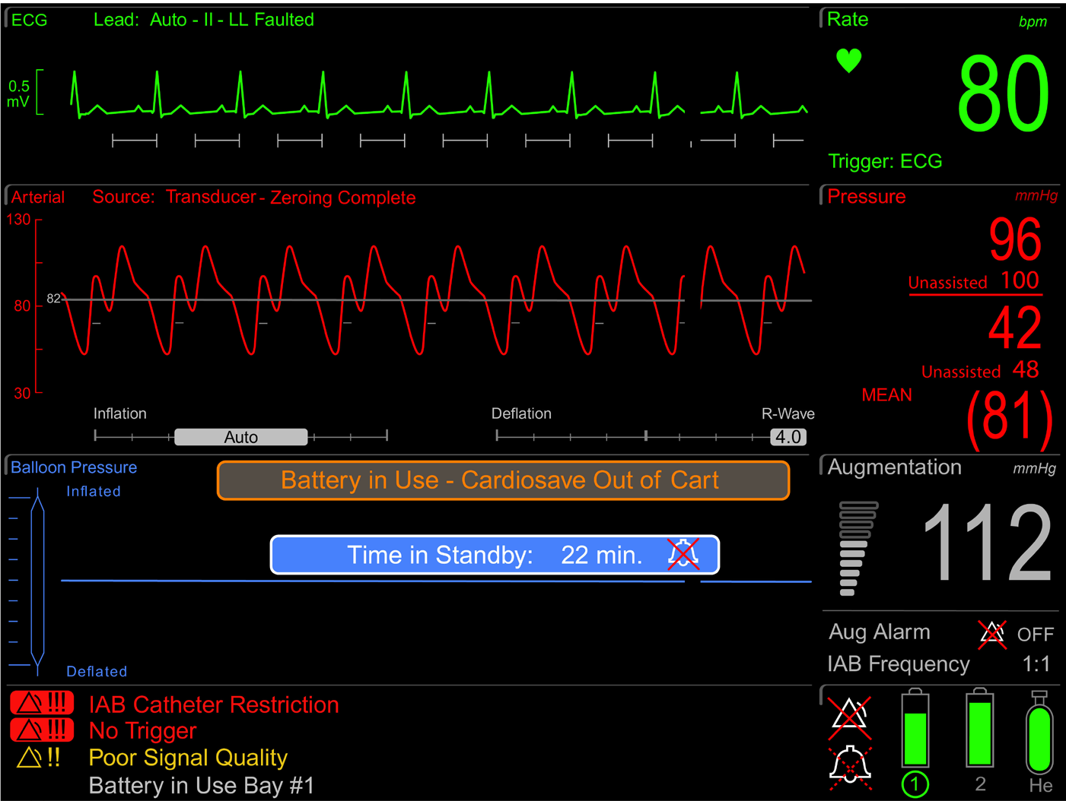
Battery in Use Bay #___
Newly added Bay Indicator on current Informational Message
Reason for update
To inform the user which of the two batteries is currently in use.
Description
A battery bay indicator was added to the current Battery in Use Informational Message on the Monitor Display to indicate which of the two batteries is currently in use.
Notes:
Field and Customer facing

Slide 42
Battery in Use Bay #___
Newly added Informational Message Help Screen
Battery in Use Bay #___
The IABP is on battery power.
If available, switch to an AC power source.
Notes:
Field and Customer facing

Slide 43
Low Battery Alarm
Notes:
Field and Customer facing

Slide 44
Low Battery Alarm
Reason for change
Improve warning time to the IABP operator of the impending end of battery operating run time.
Description
Currently, a Medium Priority Alarm exists for Low Battery Alarm when there are less than 30 minutes of battery operating time.
With this software update, a High Priority Alarm is added for when less than 15 minutes of battery operating time is remaining.
Notes:
Field and Customer facing

Slide 45

Low Battery Alarm
Current Medium Priority Alarm
    Alarm event
        Cumulative reserve of both batteries falls below 30 minutes of operating time.
    IABP response
    Cardiosave will continue to deliver active IABP therapy.
    The Medium Priority Alarm Icon - yellow flashing alarm icon with two (2) exclamation points will be visible on the Monitor Display.
    The uniform audio tone for Medium Priority Alarms will be played in the following sequence:
          three notes - pause; the cycle repeats.
    Alarm reset event(s)
    Automatically removes message and turns off tone when an AC power source is restored or when a charged battery is inserted.
Medium priority alarm icon
Notes:
Field and Customer facing

Slide 46
Low Battery Alarm
Current Medium Priority Alarm Help Screen
Low Battery
There is less than 30 minutes of battery operating time remaining
Connect system to an AC power source. If an AC power source is unavailable, insert a charged battery into the battery bay not currently in use.
Notes:
Field and Customer facing

Slide 47
Low Battery Alarm
Newly added High Priority Alarm
    Alarm event
        Cumulative reserve of both batteries falls below 15 minutes of operating time.
    IABP response
    Cardiosave will continue to deliver active IABP therapy.
    The High Priority Alarm Icon - red flashing alarm icon with three (3) exclamation points will be visible on the Monitor Display.
    The uniform audio tone for High Priority Alarms will be played in the following sequence:
          five notes - short pause - five notes - long pause; the cycle repeats.
    Alarm reset event(s)
    Automatically removes message and turns off tone when an AC power source is restored or when a charged battery is inserted.
High priority alarm icon
Notes:
Field and Customer facing

Slide 48
Low Battery Alarm
Newly added High Priority Alarm Help Screen
Low Battery
There is less than 15 minutes of battery operating time remaining.
Connect system to an AC power source. If an AC power source is unavailable, insert a charged battery into the battery bay not currently in use.
Notes:
Field and Customer facing

Slide 49
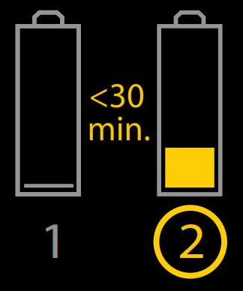
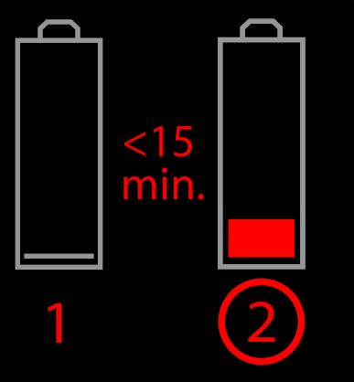
Low Battery Alarm
Battery status on Monitor Display (examples)
Medium Priority alarm
Battery 1 is depleted and battery 2 has less than 30 minutes of charge remaining.
High Priority alarm
Battery 1 is depleted and
battery 2 has less than 15
minutes of charge remaining.
Notes:
Field and Customer facing

Slide 50
Video Executive Circuit Board

Slide 51
Video Executive Circuit Board
Board reset
Reason for update
Prior to D.00 software, Cardiosave did not tolerate the presence of long communication issues between the executive and video processors.
The system’s response was to declare a system failure and stop therapy.
The D.00 update allows the system to continue delivering therapy during brief video failures.
Notes:
Field and Customer facing

Slide 52
Video Executive Circuit Board
Board reset
Description
In the event of a loss of communication or unrecoverable error on the video processor, by allowing the executive processor to power down and repower the video head whenever communication is lost.
  IABP will continue to deliver active therapy during resetting.
  These reset events will cause a brief blanking of the Monitor Display.
  An Informational Message will inform the operator that the IABP internal self-checks have detected a video communication condition, and the IABP may require service.
Notes:
Field and Customer facing

Slide 53
Video Executive Circuit Board
Newly added probable cause for existing Informational Message Help Screen
IABP May Require Maintenance
IABP Internal self-checks have detected a video communication condition that may require service.
If available, switch to another MAQUET IABP and contact MAQUET Service for system diagnosis. If another MAQUET IABP is not available, verify IABP functionality and continue use. IABP may reset the User Interface display causing a brief blanking of the video display screens. Once IABP use is discontinued, contact MAQUET Service for system diagnosis.
Notes:
Field and Customer facing

Slide 54
Cybersecurity vulnerabilities - Ripple20
Notes:
Field and Customer facing

Slide 55
Cybersecurity vulnerabilities - Ripple20
Reason for update
Previously Datascope/Getinge initiated a voluntary Medical Device Correction for the Cardiosave Hybrid and Cardiosave Rescue Intra-Aortic Balloon Pump (IABP) due to cybersecurity vulnerabilities.
These vulnerabilities may have resulted in a loss of communication to the Hospital Information System/Clinical Information System (HIS/CIS).

Slide 56
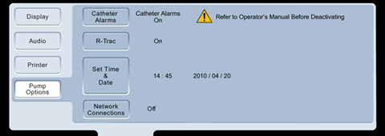
Cybersecurity vulnerabilities - Ripple20
Description
With this Field Safety Corrective Action users were instructed to disconnect the Ethernet cable from the Cardiosave Ethernet Port identified [Figure 1].
Additionally customers were given instruction for turning off Network Connections.
With the installation of D.00 software this issue is resolved.
The user is now able to reconnect the Ethernet cable to the Cardiosave Ethernet port and turn on Network Connections via the Network Connections settings in the Pump Options menu [Figure 2].
Figure 1
Figure 2

Slide 57
Network IP Address Configuration Relocated
Notes:
Field and Customer facing

Slide 58
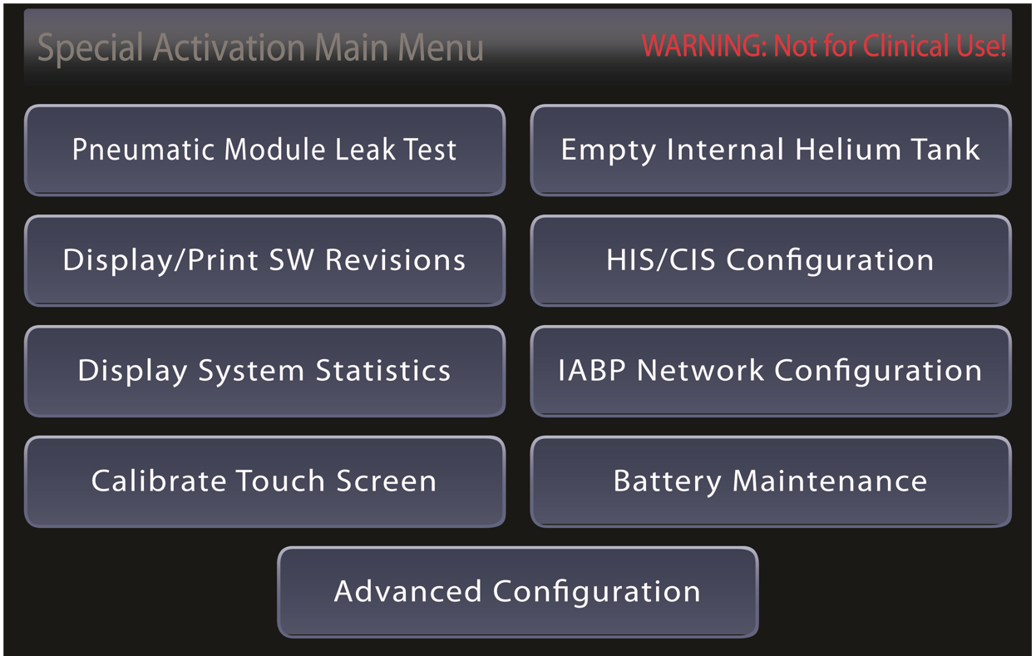
Configuration of HIS/CIS
Network IP Address Configuration Relocated
Reason for update
Service departments have requested an update to the System Diagnostics menu structure to allow hospital personnel to set the system IP address from the Special Activation Menu.

Slide 59
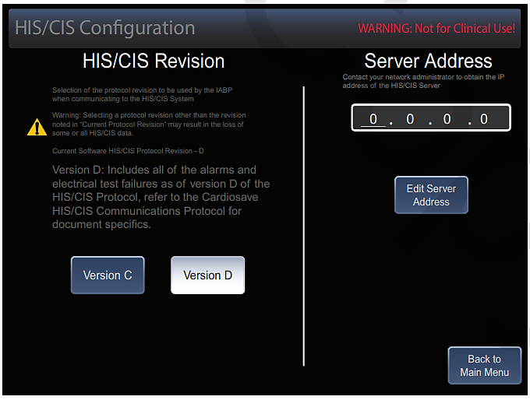
Configuration of HIS/CIS
Network IP Address Configuration Relocated
Description
The appropriate hospital personnel (i.e. biomedical engineer, hospital IT specialist, etc.) will now be able to set the system IP address from the Special Activation Menu.
Note
The settings in this menu should only be changed by an authorized technician that is familiar with data communication protocols HIS/CIS configuration.
Notes:
Field facing

Slide 60
Questions

Slide 61


MCA00001738 Rev A· Getinge and are trademarks or registered trademarks of Getinge AB, its subsidiaries, or aﬃliates in the United States or other countries · Copyright 2022 Datascope Corp. · All rights reserved · CAUTION: Federal (U.S.A.) law restricts this device to sale, distribution and use by or on the order of a physician. Refer to Instructions for Use for current indications, warnings, contraindications and precautions · 11/2022
Getinge · 45 Barbour Pond Dr., Wayne, NJ 07470, USA
Notes:
Field and Customer facing

